Slide 1
A very preliminary set of outputs from the Introduction to Population Health course
Ilan Chamovitz, D.Sc

Slide 2
Context: Services: mostly Health and Education.
Research: Information and Knowledge Management in Educational Collaborative Activities
Manchester Business School & Health Ministry, Brazil
Aims: Approaches that can be applied in course BR & UK
Information and Knowledge Management, Distance Learning,
Analytics

Slide 3
Challenges?
Access to Information – Information Management – Knowledge Management
Intangibles – Vaccination, Education
An Introduction to Population Health is a MOOC Massive Open Online Course, offered by The University of Manchester (via Coursera)
Solution
Distance Learning Courses

Slide 4
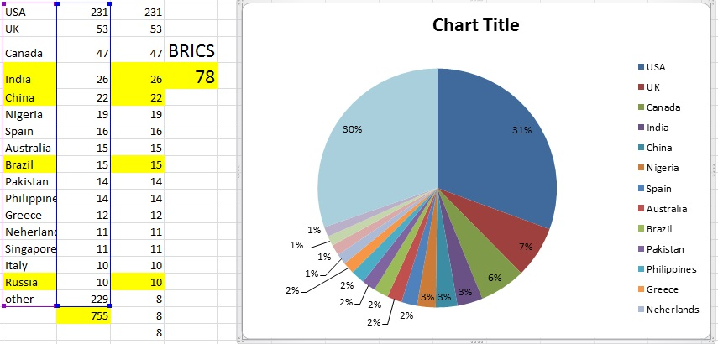
Participants
Survey question 6: What country are you from?

Slide 5
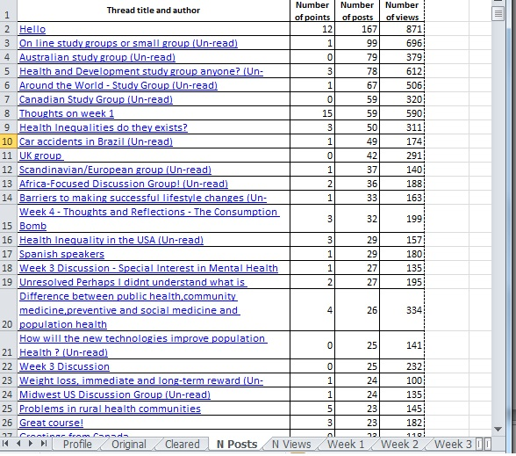
Interesting themes
Health inequalities
Car accidents in Brazil
Difference between public health community, medicine preventive and social medicine and population health
How new technologies improve Population Health

Slide 6
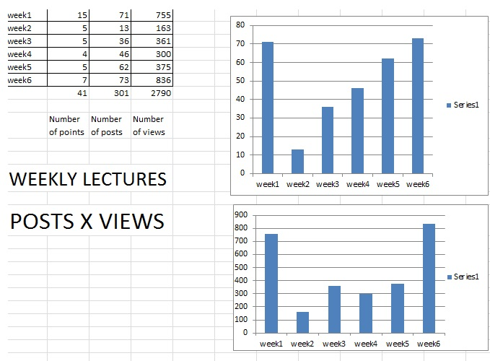
Weekly Posts
Vs Views

Slide 7
Results
Ilan Chamovitz
This preliminary analysis
Health inequalities;
Public health and other concepts.
US had more participants, followed by UK and Canada.
Together, BRICS were ranked in second.
first and last weeks - most active
posting or just viewing messages
.
ILAN@API.ADM.BR

Slide 8
Final Message
Ilan Chamovitz
Simplify and get opportunities!
ILAN@API.ADM.BR

